Slide 1
Introduction to Parallel Computing

Slide 2
Abstract
This presentation covers the basics of parallel computing. Beginning with a brief overview and some concepts and terminology associated with parallel computing, the topics of parallel memory architectures and programming models are then explored. These topics are followed by a discussion on a number of issues related to designing parallel programs. The last portion of the presentation is spent examining how to parallelize several different types of serial programs.
Level/Prerequisites: None

Slide 3
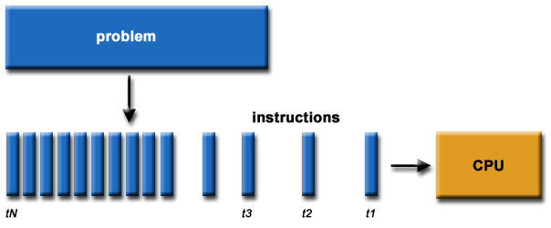
What is Parallel Computing? (1)
Traditionally, software has been written for serial computation:
  To be run on a single computer having a single Central Processing Unit (CPU);
  A problem is broken into a discrete series of instructions.
  Instructions are executed one after another.
  Only one instruction may execute at any moment in time.

Slide 4
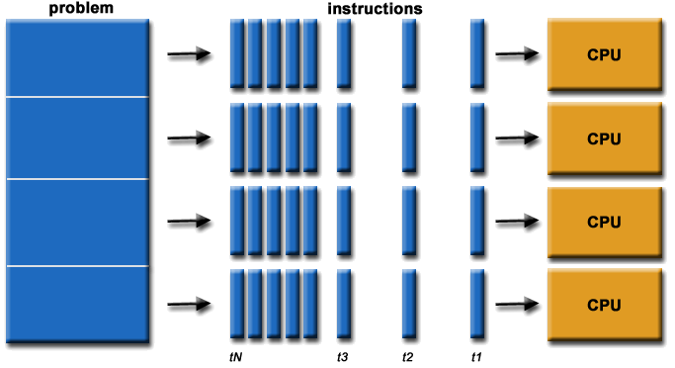
What is Parallel Computing? (2)
In the simplest sense, parallel computing is the simultaneous use of multiple compute resources to solve a computational problem.
  To be run using multiple CPUs
  A problem is broken into discrete parts that can be solved concurrently
  Each part is further broken down to a series of instructions
Instructions from each part execute simultaneously on different CPUs

Slide 5
Parallel Computing: Resources
The compute resources can include:
  A single computer with multiple processors;
  A single computer with (multiple) processor(s) and some specialized computer resources (GPU, FPGA …)
  An arbitrary number of computers connected by a network;
  A combination of both.

Slide 6
Parallel Computing: The computational problem
The computational problem usually demonstrates characteristics such as the ability to be:
  Broken apart into discrete pieces of work that can be solved simultaneously;
  Execute multiple program instructions at any moment in time;
  Solved in less time with multiple compute resources than with a single compute resource.

Slide 7
Parallel Computing: what for? (1)
Parallel computing is an evolution of serial computing that attempts to emulate what has always been the state of affairs in the natural world: many complex, interrelated events happening at the same time, yet within a sequence.
Some examples:
  Planetary and galactic orbits
  Weather and ocean patterns
  Tectonic plate drift
  Rush hour traffic in Paris
  Automobile assembly line
  Daily operations within a business
  Building a shopping mall
  Ordering a hamburger at the drive through.

Slide 8
Parallel Computing: what for? (2)
Traditionally, parallel computing has been considered to be "the high end of computing" and has been motivated by numerical simulations of complex systems and "Grand Challenge Problems" such as:
  weather and climate
  chemical and nuclear reactions
  biological, human genome
  geological, seismic activity
  mechanical devices - from prosthetics to spacecraft
  electronic circuits
  manufacturing processes

Slide 9
Parallel Computing: what for? (3)
Today, commercial applications are providing an equal or greater driving force in the development of faster computers. These applications require the processing of large amounts of data in sophisticated ways. Example applications include:
  parallel databases, data mining
  oil exploration
  web search engines, web based business services
  computer-aided diagnosis in medicine
  management of national and multi-national corporations
  advanced graphics and virtual reality, particularly in the entertainment industry
  networked video and multi-media technologies
  collaborative work environments
Ultimately, parallel computing is an attempt to maximize the infinite but seemingly scarce commodity called time.

Slide 10
Why Parallel Computing? (1)
This is a legitime question! Parallel computing is complex on any aspect!
The primary reasons for using parallel computing:
  Save time - wall clock time
  Solve larger problems
  Provide concurrency (do multiple things at the same time)

Slide 11
Why Parallel Computing? (2)
Other reasons might include:
  Taking advantage of non-local resources - using available compute resources on a wide area network, or even the Internet when local compute resources are scarce.
  Cost savings - using multiple "cheap" computing resources instead of paying for time on a supercomputer.
  Overcoming memory constraints - single computers have very finite memory resources. For large problems, using the memories of multiple computers may overcome this obstacle.

Slide 12
Limitations of Serial Computing
Limits to serial computing - both physical and practical reasons pose significant constraints to simply building ever faster serial computers.
Transmission speeds - the speed of a serial computer is directly dependent upon how fast data can move through hardware. Absolute limits are the speed of light (30 cm/nanosecond) and the transmission limit of copper wire (9 cm/nanosecond). Increasing speeds necessitate increasing proximity of processing elements.
Limits to miniaturization - processor technology is allowing an increasing number of transistors to be placed on a chip. However, even with molecular or atomic-level components, a limit will be reached on how small components can be.
Economic limitations - it is increasingly expensive to make a single processor faster. Using a larger number of moderately fast commodity processors to achieve the same (or better) performance is less expensive.

Slide 13
The future
during the past 10 years, the trends indicated by ever faster networks, distributed systems, and multi-processor computer architectures (even at the desktop level) clearly show that parallelism is the future of computing.
It will be multi-forms, mixing general purpose solutions (your PC…) and very speciliazed solutions as IBM Cells, ClearSpeed, GPGPU from NVidia …

Slide 14
Who and What? (1)
Top500.org provides statistics on parallel computing users - the charts below are just a sample. Some things to note:
  Sectors may overlap - for example, research may be classified research. Respondents have to choose between the two.
"Not Specified" is by far the largest application - probably means multiple applications.

Slide 15
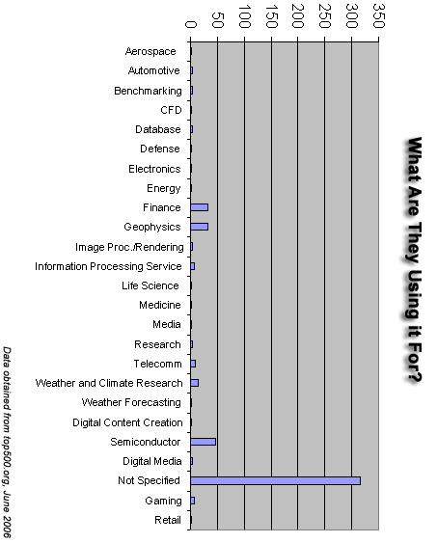
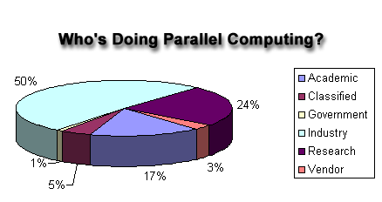
Who and What? (2)

Slide 16
Concepts and Terminology

Slide 17
Von Neumann Architecture
For over 40 years, virtually all computers have followed a common machine model known as the von Neumann computer. Named after the Hungarian mathematician John von Neumann.
A von Neumann computer uses the stored-program concept. The CPU executes a stored program that specifies a sequence of read and write operations on the memory.

Slide 18
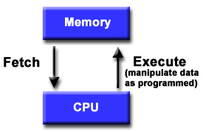
Basic Design
Basic design
  Memory is used to store both program and data instructions
  Program instructions are coded data which tell the computer to do something
  Data is simply information to be used by the program
A central processing unit (CPU) gets instructions and/or data from memory, decodes the instructions and then sequentially performs them.

Slide 19
Flynn's Classical Taxonomy
There are different ways to classify parallel computers. One of the more widely used classifications, in use since 1966, is called Flynn's Taxonomy.
Flynn's taxonomy distinguishes multi-processor computer architectures according to how they can be classified along the two independent dimensions of Instruction and Data. Each of these dimensions can have only one of two possible states: Single or Multiple.

Slide 20
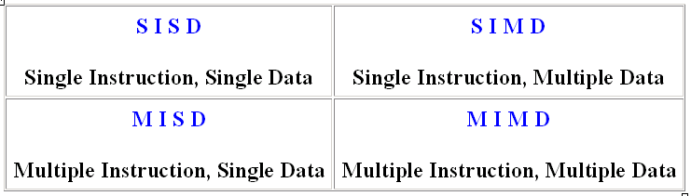
Flynn Matrix
The matrix below defines the 4 possible classifications according to Flynn

